Slide 1
CSC 112: Computer Operating Systems Lecture 3 Scheduling
Department of Computer Science,
Hofstra University
Acknowledgement: Lecture slides based on UC Berkeley CS 162: Operating Systems and System Programming

Slide 2
Operating Systems
TDT4186
Scheduling
Di Liu

Slide 3
Overview
Metrics to evaluate scheduling algorithms
Goals of Scheduling algorithms
Different scheduling algorithms,
First in first out (FIFO)
Shortest job first (SFJ)
Shortest time-to-complete first (SCTF)
Round-robin (RR)

Slide 4
Scheduling
Scheduling is an important problem in many contexts, e.g., logistics, airports, game schedule, etc.
Scheduling: policies that OS employs to determine the execution order of ready processes
Scheduling algorithms/schedulers have diverse objectives and demonstrate different effects on the system performance

Slide 5
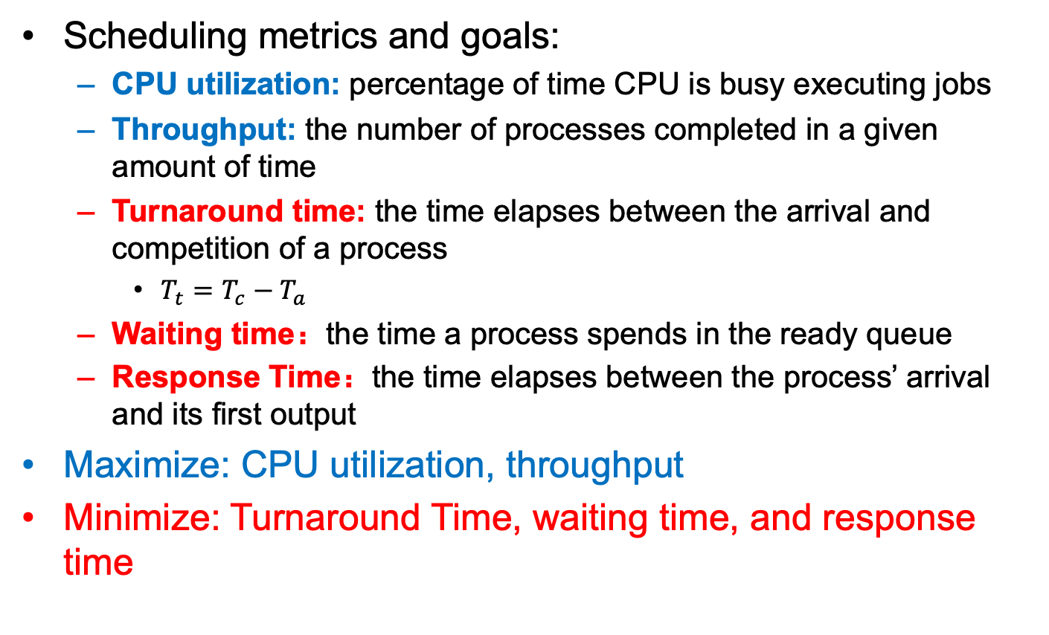
Terminologies
Scheduling metrics and goals:
CPU utilization: percentage of time CPU is busy executing jobs
Throughput: the number of processes completed in a given amount of time
Turnaround time: the time elapses between the arrival and competition of a process
$T_{t}=T_{c}−T_{a}$
Waiting time：the time a process spends in the ready queue
Response Time：the time elapses between the process’ arrival and its first output
Maximize: CPU utilization, throughput
Minimize: Turnaround Time, waiting time, and response time

Slide 6
Assumptions For Workloads
Each job runs for the same amount of time
All jobs arrive at the same time
All jobs only use the CPU (no I/O)
Run-time of each job is known
Once started, each job runs to completion (Preemption)

Slide 7
First In First Out (FIFO)
A simple and basic scheduling algorithm
First Come First Served (FCFS)
Jobs are executed in arrival time order
A first, B slightly later, and then C
Job | Arrival time (s) | Run time (s)
A | 0 | 10
B | 0 | 10
C | 0 | 10
Gantt Chart
A
B
C
0
10
20
30
Time

Slide 8
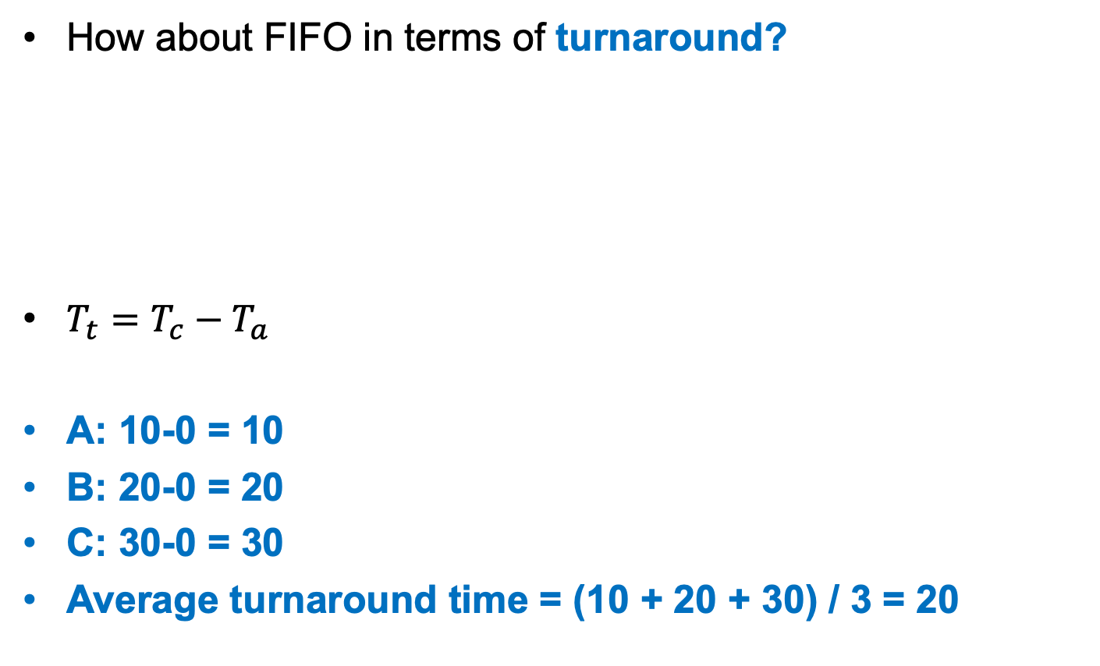
First In First Out (FIFO)
How about FIFO in terms of turnaround?
$T_{t}=T_{c}−T_{a}$
A: 10-0 = 10
B: 20-0 = 20
C: 30-0 = 30
Average turnaround time = (10 + 20 + 30) / 3 = 20
Job | Arrival time (s) | Run time (s) | Finishing Time (s)
A | 0 | 10 | 10
B | 0⁺ | 10 | 20
C | 0⁺⁺ | 10 | 30

Slide 9
Assumptions For Workloads
Each job runs for the same amount of time
All jobs arrive at the same time
All jobs only use the CPU (no I/O)
Run-time of each job is known
Once started, each job runs to completion (Preemption)

Slide 10
First In First Out (FIFO)
Average turnaround time = (70 + 80 + 90) / 3 = 80
Each job runs for the same amount of time
Job | Arrival time (s) | Run time (s) | Finishing Time (s)
A | 0 | 10 -> 70 | 70
B | 0⁺ | 10 | 80
C | 0⁺⁺ | 10 | 90
Gantt Chart
A
B
C
0
70
80
90
Time

Slide 11



First In First Out (FIFO)
Convoy effect
A scheduling phenomenon in which a number of jobs wait for one job to get off a core, causing overall device and CPU utilization to be suboptimal.
Long job
Short job
Short job

Slide 12
First In First Out (FIFO)
Aim to minimize average turnaround time, what is a better scheduling policy for the example
Average Turnaround time = (10 + 20 + 90) / 3 = 40 (80)
Job | Arrival time (s) | Run time (s)
A | 0 | 70
B | 0 | 10
C | 0 | 10
B
C
A
0
10
20
90
Time

Slide 13
Shortest Job First (SJF)
Policy: The jobs with the shortest execution time is scheduled first
Job | Arrival time (s) | Run time (s) | Finishing Time (s)
A | 0 | 70 | 90
B | 0 | 10 | 10
C | 0 | 10 | 20
 | Average Turnaround | Average Turnaround | 40
All jobs arrive at the same time
All jobs only use the CPU (no I/O)
Run-time of each job is known
Once started, each job runs to completion (Preemption)

Slide 14
Shortest Job First (SJF)
If the 4 assumptions all hold, SJF is an optimal scheduling algorithm in terms of average waiting time
All jobs arrive at the same time
Job | Arrival time (s) | Run time (s)
A | 0 | 70
B | 10 | 10
C | 20 | 10
A
B
C
0
70
80
90
Time
B and C are ready here, but cannot be scheduled due to the completion requirement
Notes:
Moving a short process before a long one decreases the waiting time of the short process more than it increases the waiting time of the long process.

Slide 15
Shortest Job First (SJF)
Job | Arrival time (s) | Run time (s) | Finishing Time (s)
A | 0 | 70 | 70
B | 10 | 10 | 80
C | 20 | 10 | 90
 | Average Turnaround | Average Turnaround | (70+70+70)/3 = 70
How can we reduce the average turnaround?
All jobs only use the CPU (no I/O)
Run-time of each job is known
Once started, each job runs to completion (Preemption)

Slide 16
Shortest Time-to-Complete First (STCF)
Once started, each job runs to completion
This assumption indicates the concept of preemption
FIFO and SJF are both non-preemptive schedulers
STCF policy: Always switch to jobs with the shortest completion time
STCF is a preemptive scheduler
STFC is optimal in terms of minimizing the average waiting time, if the assumptions hold.

Slide 17
Shortest Time-to-Complete First (STCF)
STCF may cause starvation
How about other metric?
Job | Arrival time (s) | Run time (s) | Finishing Time (s)
A | 0 | 70 | 90
B | 10 | 10 | 20
C | 20 | 10 | 30
 | Average Turnaround | Average Turnaround | (90+20+30)/3 = 46.7 (70)
A
B
C
A
0
30
90
Time
10
20

Slide 18
Response Time
Response time is another important performance metric, especially for interactive applications
FIFO
R = (0 + 30 + 50) / 3 = 26.7
SJF
R = (0 + 10 + 30) / 3 = 13.3
A better scheduler for response time?
Job | Arrival time (s) | Run time (s)
A | 0 | 30
B | 0⁺ | 20
C | 0⁺⁺ | 10

Slide 19
Round-Robin (RR)
A new concept of time quantum/time slice/scheduling quantum: a fixed and small amount of time units
Each process executes for a time slice
Switches to another one regardless whether it has completed its execution or not
If the job has not yet completed its execution, the incomplete job is added to the tail of the ready queue, FIFO queue.
Notes:
Alternate ready processes every fixed-length time-slice, you have a circular queue

Slide 20
Round-Robin (RR)
Assume that time slice is 5s
Job | Arrival time (s) | Run time (s)
A | 0 | 30
B | 0⁺ | 20
C | 0⁺⁺ | 10
A
B
C
A
B
C
A
B
A
B
A
A
0
60
Time
R = (0 + 5 + 10) / 3 = 5
Notes:
Alternate ready processes every fixed-length time-slice, you have a circular queue

Slide 21
Round-Robin (RR)
Job | Arrival time (s) | Run time (s) | Time quantum
A | 0 | 5 | 1
B | 0 | 5
C | 0 | 5
RR
R = (0 + 1 + 2) / 3 = 1
RR is a good scheduler in terms of response time
But poor in terms of turnaround time
FIFO: T = (5 + 10 + 15) / 3 = 10
SJF: T = (5 + 10 + 15) / 3 = 10
RR: T = (13 + 14 + 15) / 3 = 14

Slide 22
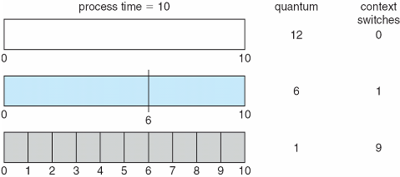
Round-Robin (RR)
If there are n processes in the ready queue and the time quantum is q, no process waits more than (n-1)q time units
The selection of time quantum size should be carefully considered (Usually 10-100 milliseconds)
Switching between processes comes at some overhead, i.e., context-switch time
Turnaround time depends on the size of time quantum
Notes:
Use a timer to implement this

Slide 23
Round-Robin (RR)
RR is also a starvation-free scheduler
Some processes never get scheduled, e.g., processes with long execution time in STCF
RR is fair, simple, and easy to implement and thus is used in modern OSs, such as Linux and MacOS.
XV6 implements a simple RR.
Notes:
when they shut down the IBM 7094 at MIT in 1973, they found a low-priority process that had been submitted in 1967 and had not yet been run.

Slide 24
Summary
There are different metrics to evaluate the performance of scheduling algorithms.
FIFO is a simple scheduler, but suffers from the convoy effect
SJF is an optimal scheduling algorithm in terms of minimizing average waiting time, if all jobs start simultaneously and know their execution times in prior
STCF is an optimal scheduling algorithm in terms of minimizing average turnaround time, if all jobs know their execution times in prior
RR is a better algorithm in terms of minimizing average response time

Slide 25
Incorporating I/O
All jobs only use the CPU (no I/O)
Every program uses I/O
Process execution consists of
CPU execution (CPU burst)
I/O wait (I/O burst)
CPU
A
A
A
B
I/O
A
A
Notes:
CPU burst
I/O burst
process execution consists of a cycle of CPU execution and I/O wait

Slide 26
Incorporating I/O
Treating each CPU burst as a sub-job
Schedule a CPU burst
Initialize the subsequent I/O burst, when the CPU burst completes
Switch to another process
A
A
A
B
CPU
A
B
A
B
A
B
CPU
Overlap
A
A
I/O
A
A
I/O
Run-time of each job is known

Slide 27
Priority-Based Scheduling
Run-time of each job is known
A priority level (integer) is assigned to each process
FIFO, SJF, STCF are special priority-based scheduling algorithms
The process with the highest priority is always scheduled
Priority-Based Scheduling:
Preemptive
Non-preemptive
Different priority assignment methods
Internal or external
The smaller number, the higher priority (usually)
Priority-based scheduling may suffer from starvation (solution: aging)
Notes:
Internal: timing constraints, memory requirements, the ratio of average I/O burst to average CPU burst
External: Importance of the process, financial considerations, hierarchy among users

Slide 28
Multi-Level Feedback Queue (MLFQ)
SJF and STCF are good for turnaround time, but poor for response time
In contrast, RR are good for response time, but terrible for turnaround time
We need a scheduling algorithms
Optimize turnaround time for batch programs
Minimize response time for interactive programs
Multi-level Feedback Queue (MLFQ) combines
Priority-based scheduling
RR

Slide 29
Multi-Level Feedback Queue (MLFQ)
MLFQ maintains a number of queues (multi-level queue)
each queue has a different priority level
Jobs which are on the same queue have same priority
Jobs are assigned to a queue
High priority
A
B
Rule 1: If priority(A) > Priority(B), A runs
A&B are scheduled before C
Rule 2: If priority(A) == Priority(B), A & B run in RR
C
Low priority

Slide 30
Multi-Level Feedback Queue (MLFQ)
MLFQ varies the priority of a job instead of having a fixed priority
MLFQ varies the priority of a job based on its observed behavior
Rule 3: When a job enters the system, it is placed at the highest priority
Rule 4a: If a job uses up an entire time slice while running, its priority is reduced (i.e., it moves down on queue).
Rule 4b: If a job gives up the CPU before the time slice is up, it stays at the same priority level

Slide 31
Multi-Level Feedback Queue (MLFQ)
Rule 3 and 4a (starts at the highest, and lower if not finished)
A long running job; Time slice is 10ms
High priority
Q2
Lower priority
Q1
Low priority
Q0
0
50
100
150
200
Time (ms)

Slide 32
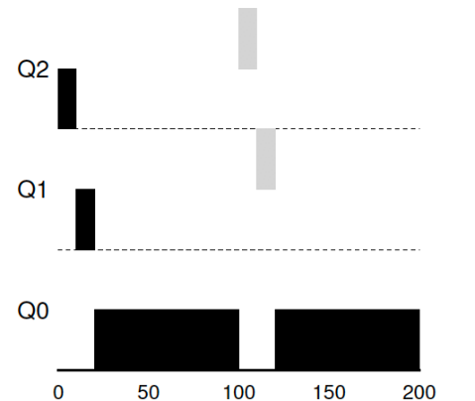
Multi-Level Feedback Queue (MLFQ)
Job A: A long-running CPU-intensive job
Job B: A short-running interactive job (20ms runtime), arrives at 100ms
A
B
High priority
Lower priority
Preemption
Low priority
Time (ms)

Slide 33
Multi-Level Feedback Queue (MLFQ)
Rule 4b (stays at the same priority);
Job A: A long-running CPU-intensive job
Job B: An interactive job that only needs CPU for 5ms before I/O
B
Remain at the same priority
A
Q2
High priority
Lower priority
Q1
Q0
Low priority
Time (ms)
Notes:
Take I/O into account

Slide 34
Multi-Level Feedback Queue (MLFQ)
What are the problems of the current MLFQ?
Starvation
Game the scheduler
Some sneaky tricks to get more resource share
Changed Behavior over time
A
B
Remain at the same priority
High priority
Q2
Q1
Lower priority
Low priority
Q0

Slide 35
Multi-Level Feedback Queue (MLFQ)
Starvation
B
Interactive jobs always occupy the CPU
C
A
Q2
High priority
Lower priority
Q1
Long-running job starves
Q0
Low priority

Slide 36
Multi-Level Feedback Queue (MLFQ)
Rule 5: After some time period S, move all the jobs in the system to the topmost queue.
B
Lower priority
C
A
Q2
High priority
Helpful for changed behavior
Q1
Q0
Low priority
Priority boost

Slide 37
Multi-Level Feedback Queue (MLFQ)
Rule 4a: If a job uses up an entire time slice while running, its priority is reduced (i.e., it moves down on queue).
Rule 4b: If a job gives up the CPU before the time slice is up, it stays at the same priority level
Rule 4: Once a job uses up its time allotment at a given level (regardless of how many times it has given up the CPU), its priority is reduced(i.e., it moves down one queue).

Slide 38
Multi-Level Feedback Queue (MLFQ)
B
A
Q2
High priority
Used up its time allotment
Lower priority
Q1
Q0
Low priority

Slide 39
Multi-Level Feedback Queue (MLFQ)
The refined set of MLFQ rules:
Rule 1: If Priority(A) > Priority(B), A runs (B doesn’t).
Rule 2: If Priority(A) = Priority(B), A & B run in RR.
Rule 3: When a job enters the system, it is placed at the highest priority.
Rule 4: Once a job uses up its time allotment at a given level (regardless of how many times it has given up the CPU), its priority is reduced(i.e., it moves down on queue).
Rule 5: After some time period S, move all the jobs in the system to the topmost queue.
Beauty of MLFQ
It does not require prior knowledge on the CPU usage of a process.

Slide 40
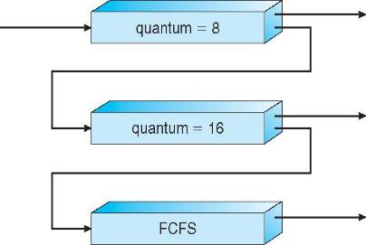
Multi-Level Feedback Queue (MLFQ)
MLFQ scheduler is defined by the following parameters
Number of queues
Time quantum of each queue
How often should priority be boosted?
Scheduling algorithms for each queue
etc.
High priority queue:
Interactive processes
Response time
Low priority queue:
Batch processes (CPU-intensive)
Turnaround time

Slide 41
Proportional Share Scheduling
Fair-share scheduler
Guarantee that each job obtain a certain percentage of CPU time.
Not optimized for turnaround or response time
Lottery scheduling
Based on the concept of tickets
The percentage of tickets denotes the share of a resource for a process
There are two processes, A and B.
Process A has 75 tickets → receive 75% of the CPU
Process B has 25 tickets → receive 25% of the CPU

Slide 42
Proportional Share Scheduling
A probabilistic way to implement lottery scheduling
Time slice (like in RR)
Scheduler knows how many tickets exist
Scheduler picks a winning tickets from the ticket pool for each time slice
Example
There are 100 tickets
Process A has 75 tickets: 0 ~ 74
Process B has 25 tickets: 75 ~ 99
Scheduler’s winning tickets:
63 85 70 39 76 17 29 41 36 39 10 99 68 83 63
Resulting scheduler:
A
B
A
A
B
A
A
A
A
A
A
B
A
B
A
A ≈ 74%
B ≈ 26%
Notes:
The longer these two jobs compete,
The more likely they are to achieve the desired percentages.

Slide 43
Completely Fair Scheduling (CFS)
Completely Fair Scheduling (CFS)
Choose the process with lowest execution time: vruntime.
Run the process for a time slice.
The current CPU scheduler in Linux (since 2.6.23, 2007)
Non-fixed time slice.
CFS assigns process`s time slice a proportion of the processor.
Priority
Enables control over priority by using nice value.
Efficient data structure.
Use red-black tree for efficient search, insertion and deletion of a process.
Notes:
Current linux kernel 6.1.1
17,900 lines of code

Slide 44
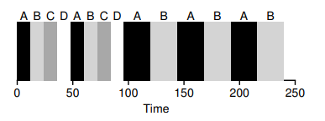
Completely Fair Scheduling (CFS)
Virtual runtime (vruntime)
Denotes how long the process has been executing.
Per-process variable
Increases in proportion with physical (real) time when it runs.
CFS will pick the process with the lowest vruntime to run next.
sched_latency
Used to determine how long a process should run before considering a switch.
A typical value is 48 (milliseconds)
process`s time slice = sched_latency / (the number of process)
N = 4, time slice = 12msec
N = 2, time slice = 24 msec
What if N = infinite, set the
minimum time slice value to 6 ms.

Slide 45
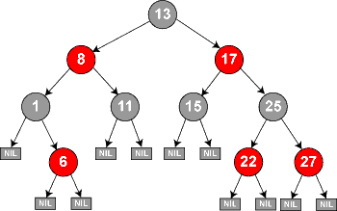
Completely Fair Scheduling (CFS)
CFS deploys a red-black tree
Balanced binary search tree
Ordered by vruntime as key
Complexity:
insertion, deletion, update -> O(logN)
find min -> O(1)

Slide 46
Completely Fair Scheduling (CFS)
How does CFS deal with I/O and sleep
When a process issues an I/O, it turns into sleep state. Then it will not accumulate vruntime
As soon as the long-sleep process is waked up, it has a small vruntime, i.e., a high priority. As a result, it is likely to monopolize CPU for a long while.
Solution: Set the vruntime of a wake-up process to the minimum value found in the RB-tree
How CFS boosts interactivity:
I/O-bound (Interactive) processes typically have shorter CPU bursts and thus will have a low vruntime – higher priority

